Slide 1

Network Layer: IPv4 Static Routing
Lecture 11 | CSE421 – Computer Networks
Department of Computer Science and Engineering School of Data & Science

Slide 2
Learning About Networks
A router can learn about remote networks in one of two ways:
Manually - Remote networks are manually entered into the route table using static routes.
Dynamically - Remote networks are automatically learned using a dynamic routing protocol.
Notes:
‹#›
6.1.1.1

Slide 3
Static Route
Manually configured route
Used to reach networks not directly connected
Does not update automatically
Changes must be applied manually
Notes:
If there is no dynamic routing protocols

Slide 4
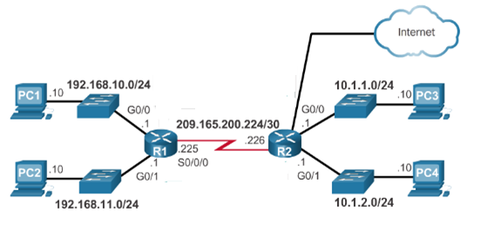
Static Routing
Table of R1
Network | Exit Int
192.168.10.0/24 | G0/0
192.168.11.0/24 | G0/1
209.165.200.224/30 | S0/0/0
Table of R2
Network | Exit Int
10.1.1.0/24 | G0/0
10.1.2.0/24 | G0/1
209.165.200.224/30 | S0/0/0
220.20.20.0/30 | G0/2
220.20.20.0/30
Directly connected
Directly connected
10.1.1.0/24
S0/0/0
10.1.2.0/24
S0/0/0
192.168.10.0/24
S0/0/0
192.168.11.0/24
S0/0/0
G0/2
S0/0/0

Slide 5
Static Route Advantages
Simple and predictable
More secure (not advertised)
Low CPU/memory usage
Notes:
‹#›
Advantage of static routing
It is most secure way of routing, since no information is shared with other routers.
It puts no overhead on resources such as CPU or memory.
No routing algorithm or update mechanisms are required. Therefore, extra resources (CPU and memory) are not required.
It is easy to implement.

Slide 6
Static Route Disadvantages
Time-consuming to configure
Not scalable for large networks
No automatic failover
Requires full network knowledge
Notes:
‹#›
6.1.1.2

Slide 7
The End

